Slide 1
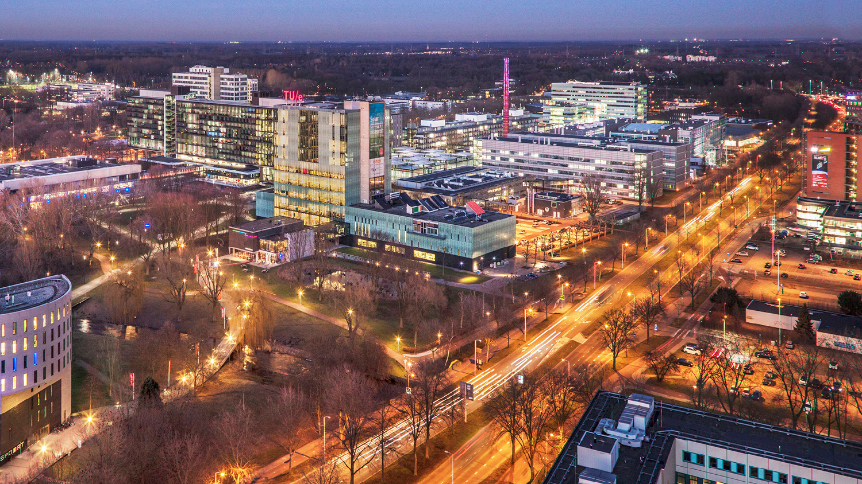
Paper Review
08/02/2024
Deniz Akyazi, MSD EngD Candidate
Department of Mathematics and Computer Science, EngD MSD Group

Slide 2
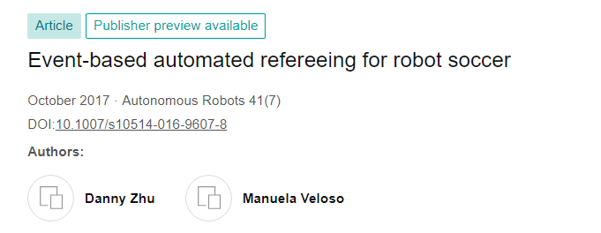

Slide 3
Contents
Introduction
Robocup SSL
Rules
Data Acquisition
Autoref
Github Pages
Results
Conclusion

Slide 4
Introduction
The challenge of creating an intelligent agent to observe data produced by a dynamic continuous process to find when the data matches some specific predefined patterns. In addition, the agent needs to make decisions about how to proceed based on the data patterns detected.
In the context of automated refereeing for the RoboCup Small Size League (SSL).

Slide 5
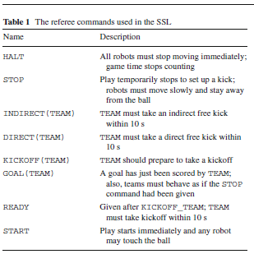
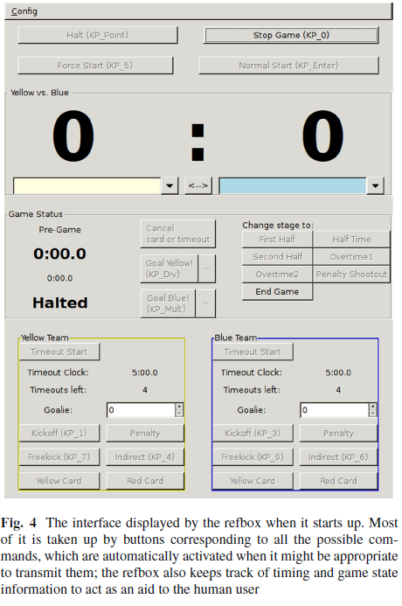
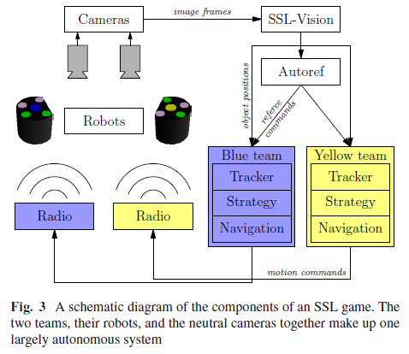
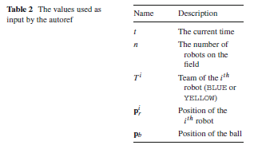
Robocup SSL
This is 16,5pt text
with single line spacing

Slide 6
Rules
Time-based rules
Robot-based rules
Ball-based rules
Each half of the game lasts 10 min, with a 5-min half time in between.
Time starts counting when the READY command is sent
Teams may also call for a timeout while play is stopped, which halts the countdown of time and; per game, each team may take up to four timeouts with a total duration of up to 5 min.
Rules that are triggered by the interactions between robots themselves.
Easier to track robots but can be countered by an element of subjectivity.
Based on the behavior of the ball, or on the interaction between the ball and the robots.
These rules tend to be the most relevant in real games, so we have focused our efforts here.

Slide 7

Data Acquisition
SSL-Vision processes data from four overhead cameras, each operating at 60 Hz, and transmits data from every frame to the teams as soon as it is available.
One part of the setup of SSL-Vision is geometry calibration.
The other part of setup is color calibration.
Three main stages of processing: color thresholding, blob detection, and pattern detection.
Overall position and orientation.
State Filtering
To also get velocities of objects, discrete-time extended Kalman filter is applied to raw SSL-Vision values.

Slide 8
Autoref
Corner Cameras
Refbox
Teams
SSL – Vision
SSL – Autoref
Decide on which event is happening according to data patterns

Slide 9
Autoref – SSL Automaton
In its most general form, a hybrid automaton consists of the following components (Henzinger 2000):
VD: A finite set of real-valued variables. A valuation is a map from each variable to a value, and ΣD is the set of all valuations.
Q: A finite set of locations.
μ1: A map from Q to sets of activities, which are C∞ functions from R≥0, the set of nonnegative real numbers, to ΣD.
μ2: A map from Q to exception sets, which are subsets of ΣD.
μ3: A map from Q2 to transition relations, which are subsets of Σ2D. We describe μ3(q1, q2) as the transition from q1 to q2.

Slide 10
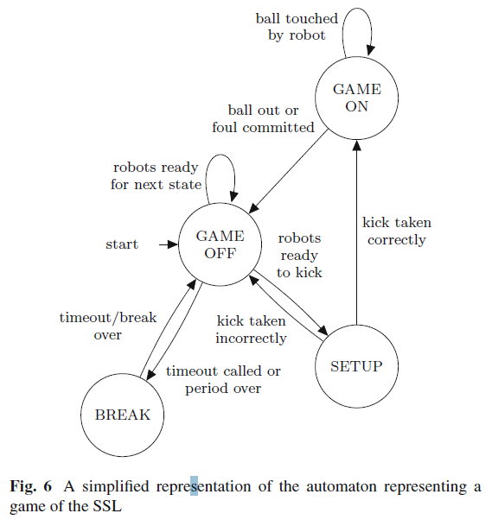
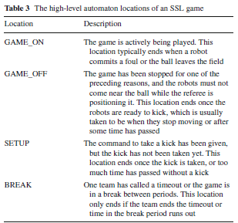
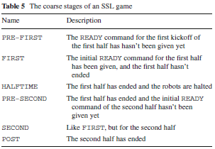
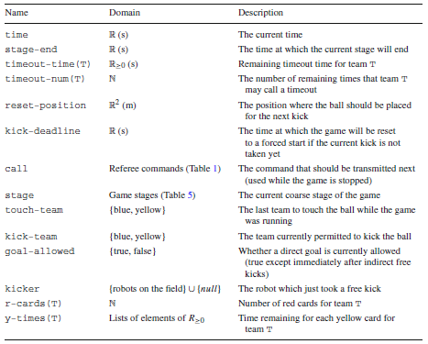
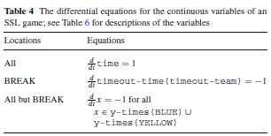
Autoref – SSL Automaton

Slide 11
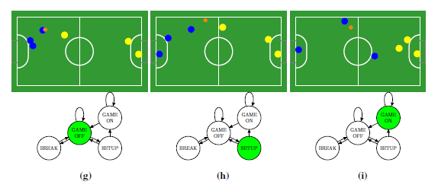
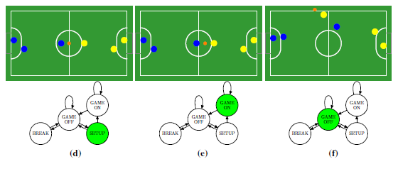
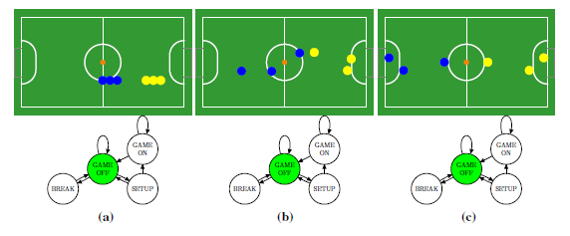
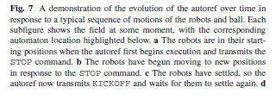
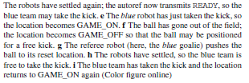
Automaton evolution and the rules

Slide 12
Event loop algorithm
Event detector implementations
In this kind of architecture, an event is any of the conditions associated with an edge in the automaton. The events we have currently implemented are:
the ball’s speed goes above the maximum limit defined in the rules,
the ball enters a goal,
the ball exits the field without entering a goal,
the robots are ready for a free kick to be taken,
a robot touches the ball,
a robot takes a free kick,
a robot dribbles the ball over a linear distance of greater than 1000mm,
a team is taking too long to take a free kick,
progress gets stuck during play, and
the end of the first or second half is reached.
Each time a new world state is available, the autoref algorithm checks whether any event has occurred; if so, it updates its state variables and may issue a command accordingly.
Ball exit
Ball touching
Robots settled

Slide 13
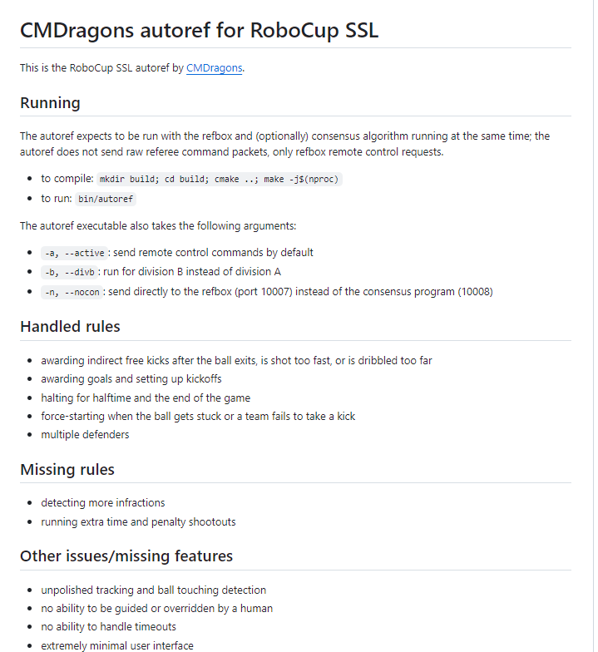
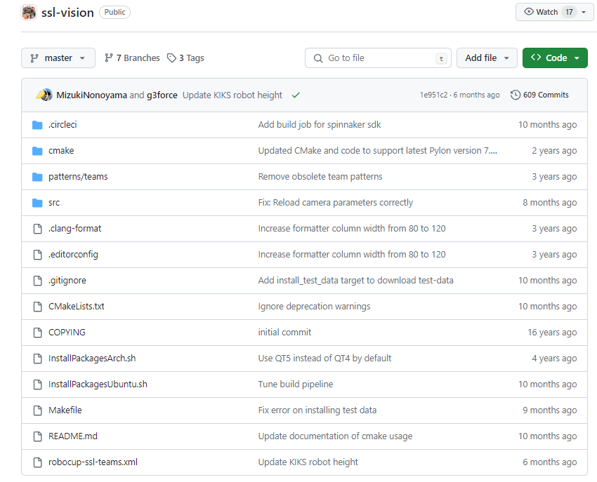
SSL Vision Github
SSL Autoref Github

Slide 14
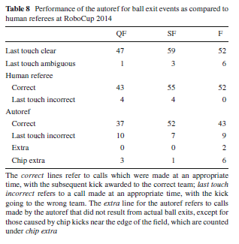
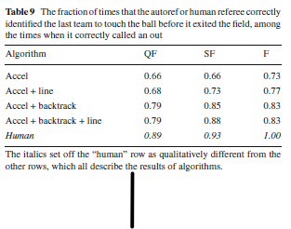
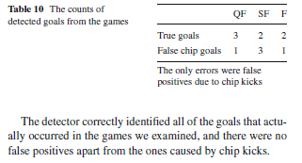
Results – Human Referee Comparison

Slide 15
Conclusion
Pros & Cons
+ Fast and real-time
+ Directly reads info from SSL-Vision (global solution)
+ Doesn’t need extra vision setup other than existing corner cameras
+ Actually, transmits the decision to team
- Requires Refbox – limited to refbox commands
- Only has position, orientation & velocity information

